Slide 1

AVL Trees
By John, Samuel, Ken, and Rick

Slide 2
Introduction
Welcome to this presentation on AVL Trees
AVL Trees are a type of self-balancing binary search tree that was invented by Adelson-Velskii and Landis in 1962
This presentation will cover the basic concepts of AVL Trees, their properties, and how they work

Slide 3

Binary Search Trees
A binary search tree is a data structure that organizes data in a tree-like structure
Each node in a binary search tree has a value and two children, referred to as the left and right child
The left child contains values smaller than the node's value, and the right child contains values larger than the node's value

Slide 4

The Need for AVL Trees
Binary search trees can become unbalanced if data is inserted in a certain order
This can result in an inefficient search time, as some parts of the tree will be deeper than others
AVL Trees were invented to solve this problem by maintaining a balance factor for each node

Slide 5
Balance Factor
The balance factor of a node in an AVL Tree is the difference between the heights of the left and right subtrees
The balance factor of a node can be -1, 0, or 1 in an AVL Tree
The tree is considered balanced if the balance factor of each node is within this range

Slide 6
Rotations
If a node's balance factor is outside the range of -1 to 1, the tree needs to be rebalanced
This is achieved by performing rotations on the nodes in the tree
There are four types of rotations: left rotation, right rotation, left-right rotation, and right-left rotation

Slide 7

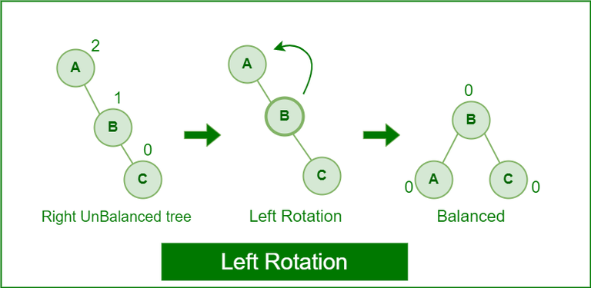
Left Rotation
A left rotation is performed when the balance factor of a node is greater than 1
The left rotation moves the node down to its left child and moves the right child up to the original node's position
This balances the height of the left and right subtrees

Slide 8

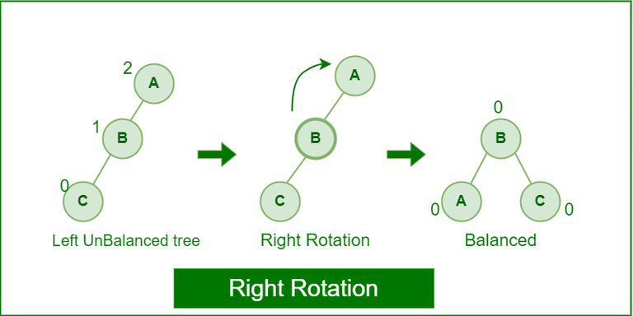
Right Rotation
A right rotation is performed when the balance factor of a node is less than -1
The right rotation moves the node down to its right child and moves the left child up to the original node's position
This balances the height of the left and right subtrees

Slide 9
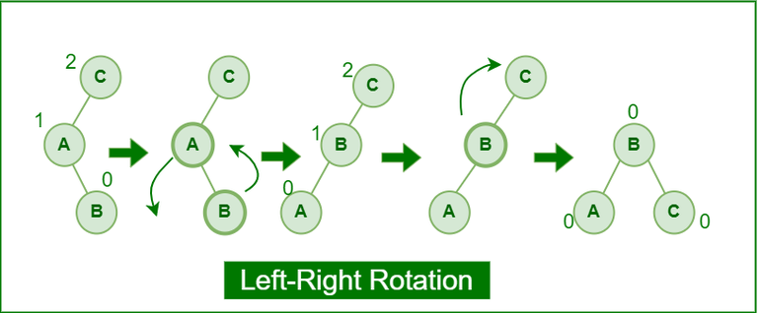
Left-Right Rotation
A left-right rotation is performed when the balance factor of a node's left child is less than -1
The left-right rotation involves a left rotation on the left child, followed by a right rotation on the original node
This balances the height of the left and right subtrees

Slide 10

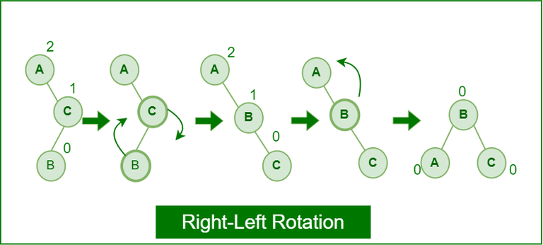
Right -Left Rotation
A right-left rotation is performed when the balance factor of a node's right child is greater than 1
The right-left rotation involves a right rotation on the right child, followed by a left rotation on the original node
This balances the height of the left and right subtrees

Slide 11

Real World Application
Databases: AVL trees can be used to implement indexing in databases. They provide efficient search, insertion, and deletion operations on large data sets.
Text editors: AVL trees can be used to implement efficient algorithms for searching and manipulating text in text editors. They can be used to implement features like search, replace, and undo.
Compilers: AVL trees can be used to implement symbol tables in compilers. Symbol tables are used to store information about variables, functions, and other symbols used in the code. AVL trees provide efficient search, insertion, and deletion operations on symbol tables.
Network routing: AVL trees can be used to implement routing tables in computer networks. Routing tables are used to store information about the paths that data packets can take to reach their destination. AVL trees provide efficient search and insertion operations on routing tables.

Slide 12
Comparison
A self-balancing binary search tree is a type of binary search tree that automatically keeps its height balanced as elements are inserted or deleted.
In a binary search tree, the height of the tree can have a significant impact on the performance of operations such as search, insert, and delete.
A self-balancing binary search tree is designed to ensure that the height of the tree does not become too large, which would lead to degraded performance.

Slide 13

AVL vs Self Balancing Binary
Self-balancing binary search trees achieve this balance through a variety of techniques, such as rotating or restructuring the tree when necessary to maintain a specific balance condition.
The balance condition varies depending on the type of self-balancing binary search tree used.
For example, AVL Trees maintain a balance condition where the heights of the left and right subtrees of any node differ by at most one, while Red-Black Trees maintain a balance condition where the tree is always approximately balanced, with the maximum difference in height between any two subtrees being at most a factor of two.

Slide 14

Advantages vs Disadvantages
Advantages of AVL Tree:
AVL trees can self-balance.
It is surely not skewed. (Suddenly changes direction or position)
It provides faster lookups than Red-Black Trees
Better searching time complexity compared to other trees like binary trees.
Height cannot exceed O(logn), whereas N is the total number of nodes in the tree.
Disadvantages of AVL Tree:
It is difficult to implement.
It has high constant factors for some of the operations.
Less used compared to Red-Black trees.
Due to its rather strict balance, AVL trees provide complicated insertion and removal operations as more rotations are performed.
Take more processing for balancing.

Slide 15

Conclusion
In conclusion, AVL Trees are a type of self-balancing binary search tree that use a balance factor to maintain balance.
Rebalancing the tree is achieved through rotations, which can be left, right, left-right, or right-left rotations.
AVL Trees have a guaranteed worst-case search time of O(logn) and remain balanced even after insertions and deletions.
Thank you for attending this presentation on AVL Trees!

